Slide 1
Thursday 11/21/19
Cross a Homozygous Dominant purple round pea plant with a Homozygous Recessive white, wrinkled pea plant.
What are the gametes? What percentage of the offspring will be heterozygous for both traits?

Slide 2
Order to Glue down Notes
Pg. 100 Law of Independent Assortment
Pg. 101 The Dihybrid Cross one
Pg. 102 Polygenic Inheritance
Pg. 103 Eye Color Notes (Both)

Slide 3
Pedigrees!!

Slide 4
crossed
offspring

Slide 5
inherited

Slide 6
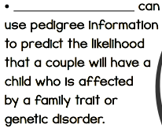
Genetic Counselors

Slide 7
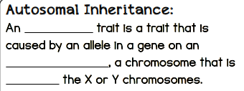
autosomal
autosome
NOT

Slide 8
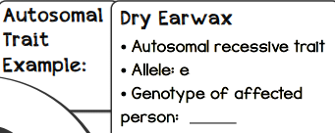
ee

Slide 9
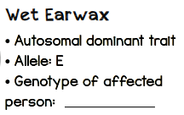
EE or Ee

Slide 10
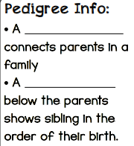
marriage line
children line

Slide 11
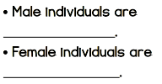
squares
circles

Slide 13
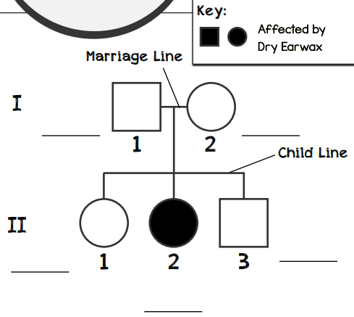
Ee
Ee
EE or Ee
EE or Ee
ee

Slide 14
Unknown Trait!!

Slide 16
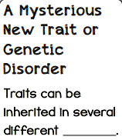
patterns

Slide 17
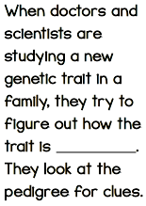
inherited

Slide 18
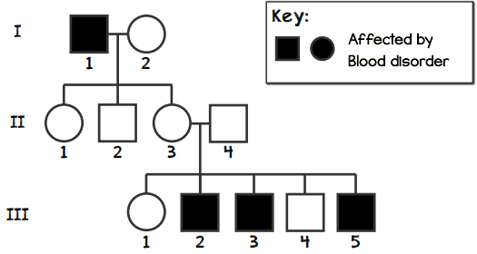

Slide 19
Clue #1
Person I-l has three children and none of them are affected and II-3 (his daughter) has affected children. This disorder is most likely recessive.

Slide 21
Clue #2
I-1 is male and all of his affected grandchildren are male. This suggests that the blood disorder allele is found on his X chromosome, which was passed to his daughter (II-3), and then passed to three of his grandsons (III-2, III-3, and III-5)

Slide 23
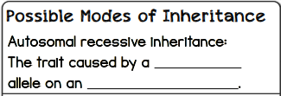
recessive
autosome

Slide 24
dominant
autosome

Slide 25
dominant
X

Slide 26
recessive
X

Slide 27
males
Y

Slide 28
mother
Mitochondrial DNA

Slide 29
Conclusion
The blood disorder is most likely due to a recessive allele on the X chromosome.

Slide 31
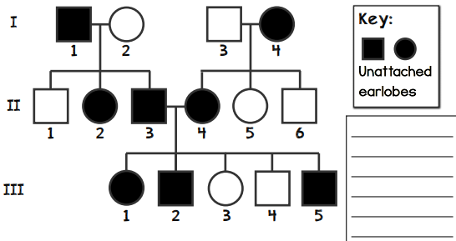

Slide 32
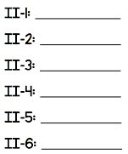
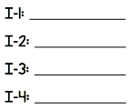

Slide 34
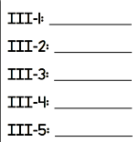

Slide 35
II-3 & II-4’s next child has a 75% chance for unattached earlobes!

Slide 36
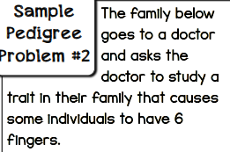

Slide 37
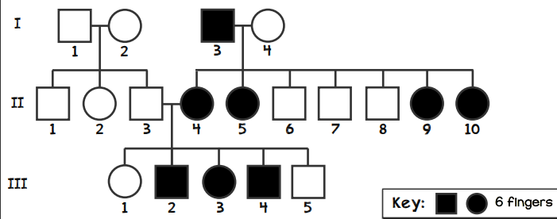

Slide 38
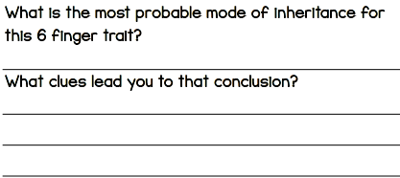
X-linked Dominance
Only daughters of I-3 are affected and none of his sons!

