Slide 1
Friday 11/1/19
1. What is the end result of meiosis? Be specific!
2. When does Crossing Over happen?

Slide 2
Unit 6 – Genetics Pocket page, page 78
Write in RED marker
Fold the bottom right corner of page 78 to make a pocket divider.
Glue along the spiral.
Unit 6 - Genetics

Slide 3
Genetic Diversity: Independent Assortment

Slide 4
Random Orientation in the Middle
-When homologous ________________ of chromosomes pair up and line up in the middle of the cell during ____________________, the way they are facing is random.
pairs
metaphase

Slide 5
Random Orientation in the Middle
-For each mother cell that undergoes meiosis, the resulting _________________ can be different!
gametes

Slide 6
Genetic Diversity
-Independent assortment increases the _____________________________ of _____________________.
genetic diversity
offspring

Slide 7
Genetic Diversity
-Even if two offspring have the same _________________, the gametes that joined to form each __________________ are different.
parents
offspring

Slide 8
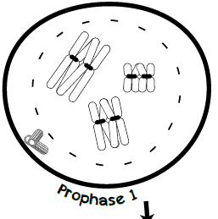
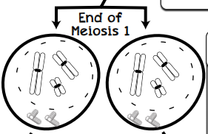
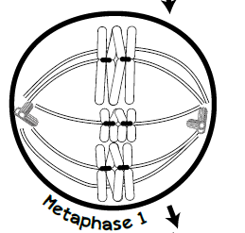
Anaphase 1 and
Telophase 1

Slide 9
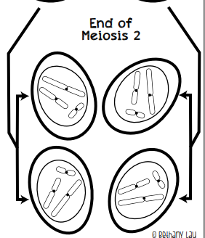
Prophase 2,
Metaphase 2,
Anaphase 2 and
Telophase 2

Slide 10
Genetic Diversity: Crossing Over

Slide 11
Synapsis
-When homologous pairs of chromosomes pair up during ____________________ and “stick together”, that process is called __________________.
Prophase I
synapsis

Slide 12
Synapsis
-Sometimes, these sister chromosomes _____________ segments of DNA. The exact location where the crossing over happens is called the _______________________.
swap
chiasma

Slide 13
Genetic Diversity
-The crossing over happens a lot and greatly ___________________________ genetic diversity.
increases

Slide 14
Genetic Diversity
-It ____________________ the gene regions, making sure children are never exactly like their ________________ __________________________.
“shuffles”
parents
or siblings

Slide 15
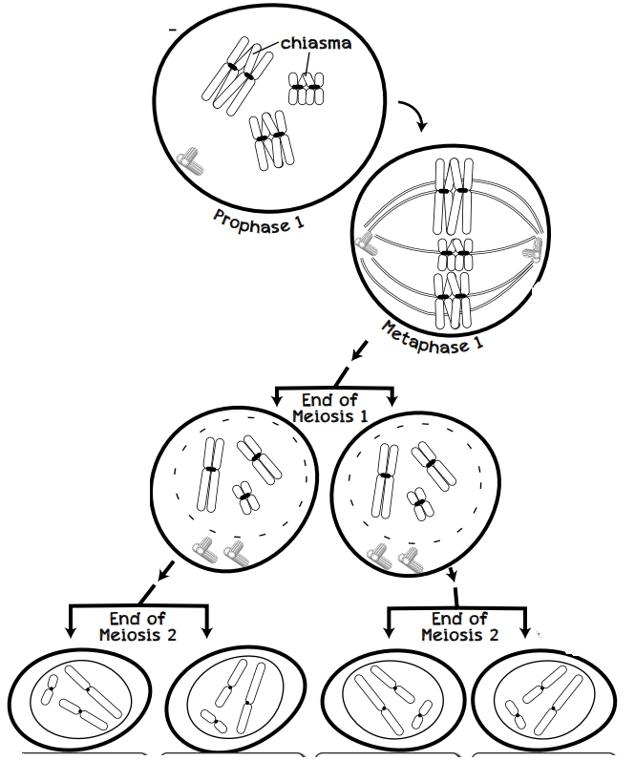

Slide 17
Genetic Diversity
-A chromosome that results from a crossover is called a _____________________ chromosome.
recombinant

Slide 18
Genetic Diversity
-Gametes with _______________________ chromosomes are called _______________________ ______________________.
recombinant
recombinant
gametes

Slide 19
Genetic Diversity
-Gametes that have chromosomes that are just like their parents’ chromosomes are called ____________________ gametes.
parental

Slide 20
Genetic Diversity: Nondisjunction

Slide 21
Meiosis Mistake
-Sometimes at metaphase, sister chromosomes ______________________ ________________________ and both sisters are pulled towards one pole.
fail to
separate

Slide 22
Meiosis Mistake
-In human meiosis, scientists believe __________________________ happens quite often.
nondisjunction

Slide 23
Meiosis Mistake
-_____________________ that form after a nondisjunction event often are _____________________ and do not produce __________________ that survive to birth.
Gametes
not viable
offspring

Slide 24
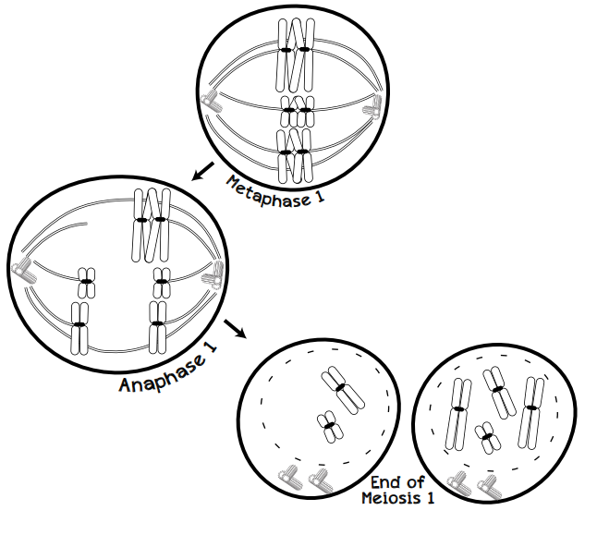

Slide 25
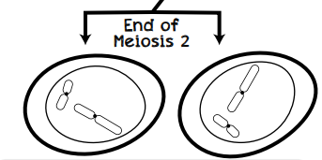
-When this gamete joins with a normal gamete from the other parent, the offspring will have ____________________ chromosome than normal.
-This is called _________________ and usually results in early embryonic death.
one less
monosomy

Slide 26
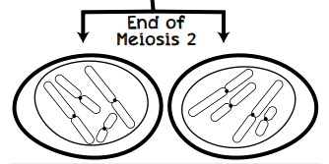
-When this gamete joins with a normal gamete from the other parent, the offspring will have ____________________ chromosome than normal.
-This is called _________________ and usually results in early embryonic death.
one more
trisomy

Slide 27
PRE-AP Table of Contents
Title | Left Page
DNA vs RNA Chart | 67
DNA Replication Enzymes | 69
Gene Structure | 71
RNA Types | 73
Mutations: Base Substitutions | 75
Codon Chart | 77
 | 79
Meiosis 1 and Meiosis 2 | 81
Crossing Over | 83
Title | Right Page
DNA Replication | 68
Replication Bubble | 70
Transcription | 72
Translation | 74
Mutations: Frameshift | 76
Unit 6: Genetics | 78
Meiosis Overview | 80
Independent Assortment | 82
Nondisjunction | 84

