Slide 1
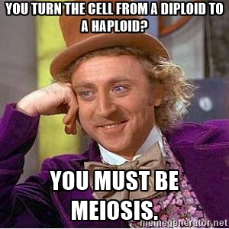
Tuesday 11/5/19
Pick up notes & get your journals.
Warm-up:
What type of cells does Meiosis make?
How many cells does meiosis make?
What is crossing over?

Slide 2
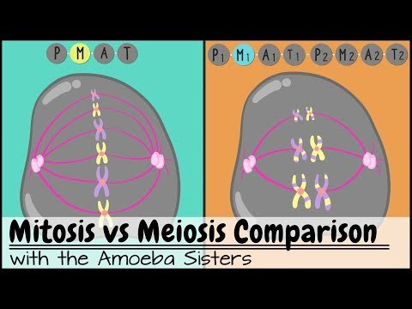

Slide 3
Mitosis vs. Meiosis 10 MINUTES!!!
 | Mitosis | Meiosis
In what type of cells does division take place?
How many divisions are there?
How many daughter cells are produced?
Are the daughter cells diploid or haploid?
Are the daughter cells identical to or different than parent cell?
Does crossing over occur? If so, during what stage?
During what stage do the sister chromatids separate?
Chromosome Number
Role
Somatic (body)
Gametes (sex)
1
2
2
4
diploid
haploid
identical
different
NO
Yes – Prophase I
Anaphase
Anaphase II
Same - 46
Half - 23
Growth, repair, replace
Reproduction

Slide 4
Human Karyotyping

Slide 5
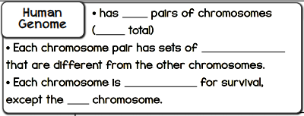
23
46
genetic regions
essential
Y

Slide 6
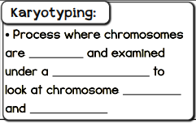
stained
microscope
shape
number

Slide 7
Sex Determination
The 23rd pair is the _______ pair and usually determines biological ______ in humans.
XY
sex

Slide 8
Sex Determination
The presence of a specific genetic region on the ______ chromosome determines ______________. Most human males have an _____ and a ___ chromosome.
Most human females have two _____ chromosomes
Y
“maleness”
X
Y
X

Slide 9
Atypical Karyotype

Slide 10
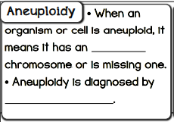
extra
karyotyping

Slide 11
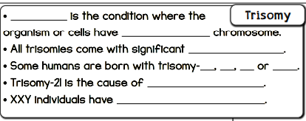
Trisomy
One extra
health concerns
13
18
21
XXY
Down syndrome
Klinefelter syndrome

Slide 12
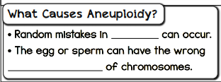
meiosis
number

Slide 13
Turner’s syndrome
X

Slide 14
Chromosomal Abnormalities

Slide 15
Deletion
A chromosome with a deletion has a portion of the chromosomes ___________.
Often an essential ________ is __________ and this can have serious health concerns.
missing
gene
missing

Slide 16
Duplication
A chromosome with a duplication has a portion of the chromosome __________________________.
________ duplications often have serious health effects.
Duplicated or repeated
Large

Slide 17
Inversion
A chromosome with an inversion has a section of the inversion ______________ ________________ in the chromosome.
If the ________ ________ of the inversion are in the middle of an important _________, then it can cause several health effects.
flipped or
“upside down”
break
points
gene

Slide 18
Translocation
When a section of one chromosome is __________ to another chromosome, a translocation has occurred.
moved

Slide 19
Translocation
When part of chromosome A is swapped with part of chromosome B, it is called a ______________ ______________.
Some translocations have health effects and some do not.
reciprocal
translocation

