Slide 1
Tuesday 8/20/19
Pick up notes from the back table & get out your journals.
Warm-Up
Turn in your homework
Discussion question: What level or organization are you & I part of?

Slide 2
Tuesday 8-20-19
Objective
We will identify what a biomolecule is and the monomers of the different types of biomolecules.
Product
I will differentiate between the four types of biomolecules.

Slide 3
Topic
Topic: Biomolecules/Macromolecules

Slide 4
Vocabulary
Vocabulary: biomolecule, macromolecule, monomer, polymer, carbohydrate, lipid, protein, nucleic acid

Slide 5
EQ (Essential Question)
EQ: What are the differences between the four biomolecules?

Slide 6
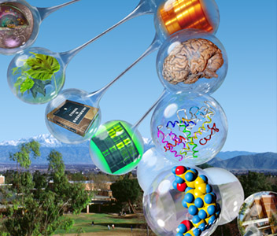
Biochemistry
Biomolecules

Slide 7
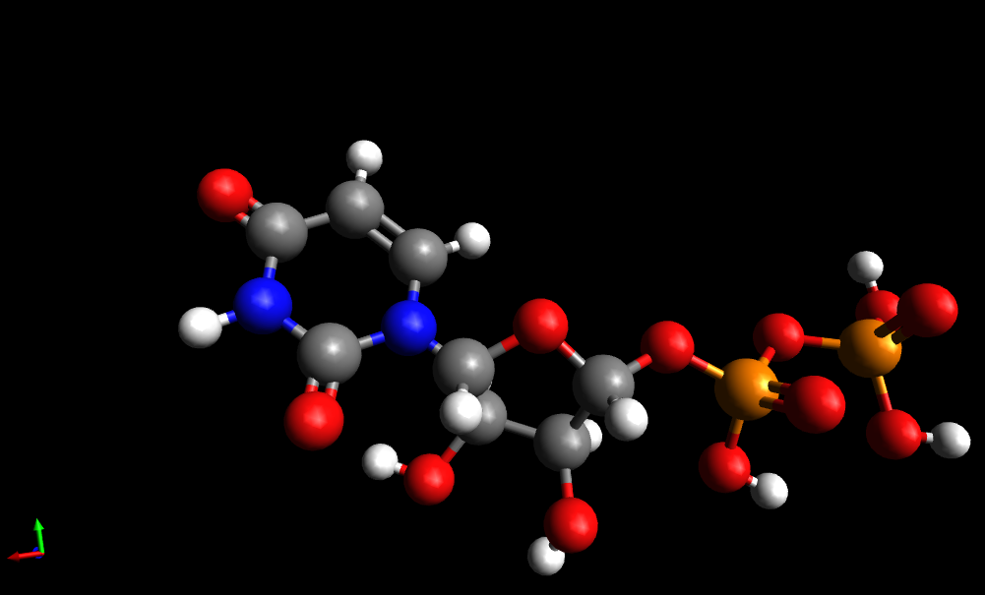
What is a Biomolecule?
Large organic molecule that is made of several subunits
Also called: Macromolecules or Polymers

Slide 8
What are biomolecules made of?
C H O P N
Carbon (C)
Hydrogen (H)
Oxygen (O)
Phosphorus (P)
Nitrogen (N)

Slide 9
Monomers vs. Polymers
Monomers:
Small subunits or building blocks that make up polymers (mono = one)
Polymers:
A large molecule made up of many monomers (poly = many)
Notes:
Ask students to think about the prefixes “mono” and “poly” to try to determine differences between these two molecules. Then, show the correct definitions.

Slide 10
How are Polymers formed?
Building Polymers | Monosaccharide | Monosaccharide | Carbohydrate (Polysaccharide)
Monomer
Monomer
Polymer

Slide 11
How are Polymers broken down?
Breaking Polymers | Protein | Amino Acid | Amino Acid
Polymer
Monomer
Monomer

Slide 12
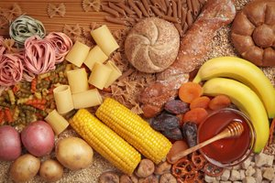
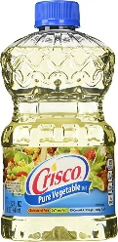
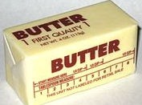
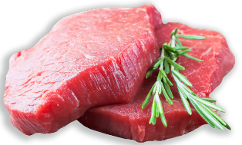
4 groups of biomolecules
Carbohydrates
Saccharides
Lipids
Fatty Acids
Polymers
Proteins
Amino Acids
Nucleic Acids
Nucleotides

Slide 13
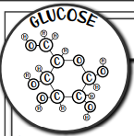
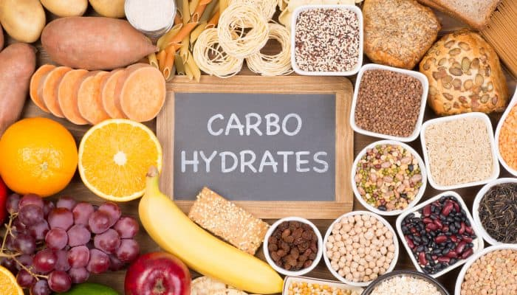
Carbohydrates
Elements: C, H, O
Functional Groups: hydroxyl, carbonyl
Notes:
Ask students to think about the prefixes “mono” and “poly” to try to determine differences between these two molecules. Then, show the correct definitions.

Slide 14
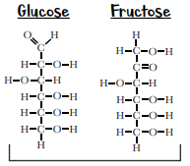
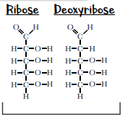
Monosaccharides : Structure
Hexose 6-carbon Pentose 5-Carbon
Notes:
Ask students to think about the prefixes “mono” and “poly” to try to determine differences between these two molecules. Then, show the correct definitions.

Slide 15
Monosaccharides : Function
The carbon-carbon bonds “carry” energy that cells can harvest and use to run cell processes
Monosaccharides are building blocks for other molecules or structures in the cell
Notes:
Ask students to think about the prefixes “mono” and “poly” to try to determine differences between these two molecules. Then, show the correct definitions.

Slide 16
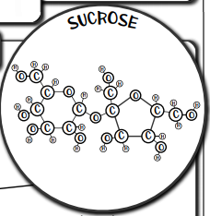
Disaccharides
A way for cells to store monosaccharides in a way that is still easy to quickly break down
Found in a lot of fruit
Table sugar is made of sucrose
Hexose 6-carbon Pentose 5-Carbon
Notes:
Ask students to think about the prefixes “mono” and “poly” to try to determine differences between these two molecules. Then, show the correct definitions.

Slide 17
Polysaccharides
Cellulose
Plants make chains of saccharides bonded this way to form cellulose
Strong molecule that plants use to build their cell walls around their cells
Starch
Plants store extra sugar as starch
These bonds are more easily broken than the bonds in cellulose
Often stored in the roots of plants for the winter when it’s more difficult to produce more sugar through photosynthesis
Notes:
Ask students to think about the prefixes “mono” and “poly” to try to determine differences between these two molecules. Then, show the correct definitions.

Slide 18
Polysaccharides
Glycogen: How humans store some extra sugar so it’s easy to access:
Excess glucose can be stored as glycogen in muscle and liver cells
When muscle/liver cells sense there is not enough simple sugars to burn for energy, they break down the glycogen into simple sugars again.
Notes:
Ask students to think about the prefixes “mono” and “poly” to try to determine differences between these two molecules. Then, show the correct definitions.

Slide 19
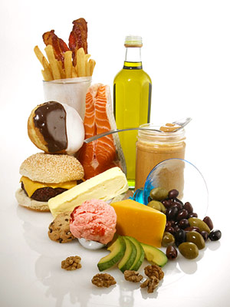
Lipids
Elements: C, H, O
Functional Groups: carboxylic acid
Notes:
Ask students to think about the prefixes “mono” and “poly” to try to determine differences between these two molecules. Then, show the correct definitions.

Slide 20
Fatty Acids: Structure
Saturated: no double bonds, forms straight chain
Trans-unsaturated: has double bond, but chain is still often pretty straight
Cis-unsaturated: has double bond and chain is bent.
Notes:
Ask students to think about the prefixes “mono” and “poly” to try to determine differences between these two molecules. Then, show the correct definitions.

Slide 21
Lipids
Function:
Fatty acids can be broken down in cells to provide energy!
Fatty acids are also used in the construction of several cellular structures
Notes:
Ask students to think about the prefixes “mono” and “poly” to try to determine differences between these two molecules. Then, show the correct definitions.

Slide 22
Triglycerides: 3 Fatty Acids & Glycerol
Glycerol: connector molecule
Function
Triglycerides can be stored in cells or body tissue as fat, to save energy for later
Modified triglycerides like phospholipids are used to form the cell membrane.
Notes:
Ask students to think about the prefixes “mono” and “poly” to try to determine differences between these two molecules. Then, show the correct definitions.

Slide 23
Other Important Lipids
Sterol lipids (steroids):
Cholesterol is also a lipid. Many hormones and signaling molecules are made with cholesterol.
Wax molecules are also lipids. They are created by reacting a fatty acid with an alcohol. Animals and plants use wax-type lipids to prevent water from getting into a tissue.
Notes:
Ask students to think about the prefixes “mono” and “poly” to try to determine differences between these two molecules. Then, show the correct definitions.

Slide 24
Nucleic Acids
Elements: C, H, O, P, N
Monomer: Nucleotides, which are made of a phosphate group, a sugar and a base.
Notes:
Ask students to think about the prefixes “mono” and “poly” to try to determine differences between these two molecules. Then, show the correct definitions.

Slide 25
Nucleic Acids: Function
DNA is a like a giant recipe book in the cell that holds the instructions for building proteins and other things in the cell.
DNA in human cells is kept in the nucleus of the cell.
Notes:
Ask students to think about the prefixes “mono” and “poly” to try to determine differences between these two molecules. Then, show the correct definitions.

Slide 26
Nucleic Acids: Structure of DNA
Two strands of DNA form a helix, like the vertical sides of a ladder.
The two strands have backbones made of the phosphate and sugar groups
Notes:
Ask students to think about the prefixes “mono” and “poly” to try to determine differences between these two molecules. Then, show the correct definitions.

Slide 27
Nucleic Acids: Structure of DNA
The ladder "rungs" are made of two bases, one base on one strand and one base from the other strand.
These base pairs are shown on the right and they are held together with hydrogen bonds
Notes:
Ask students to think about the prefixes “mono” and “poly” to try to determine differences between these two molecules. Then, show the correct definitions.

Slide 28
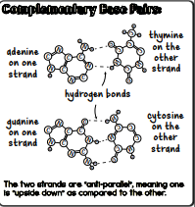
Complementary Base Pairs:
Adenine (A) goes with Thymine (T).
Cytosine (C) goes with Guanine (G).
The two strands are "anti-parallel" meaning one is "upside down" as compared to the other.
Notes:
Ask students to think about the prefixes “mono” and “poly” to try to determine differences between these two molecules. Then, show the correct definitions.

Slide 29
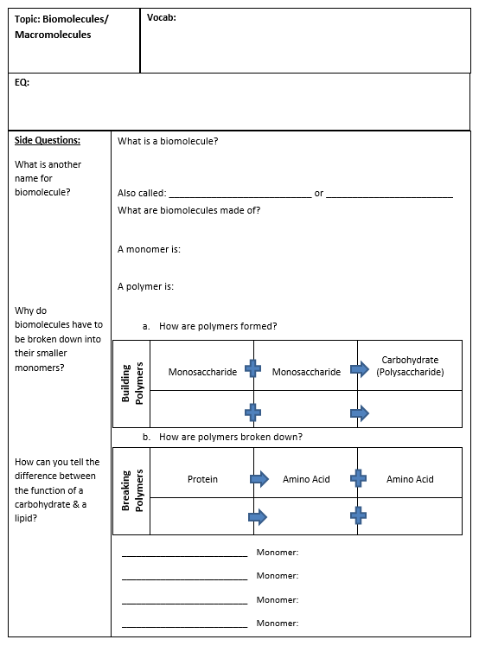
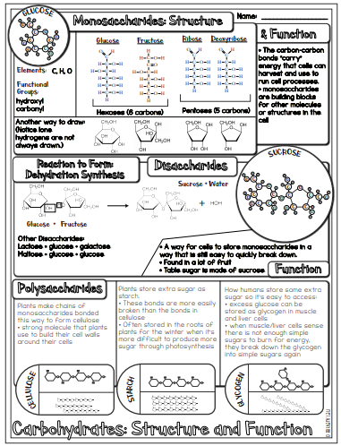
Biomolecules Notes page 13
13
14
Glue with an ANCHOR TAB onto page 13
Add to your table of contents!

Slide 30
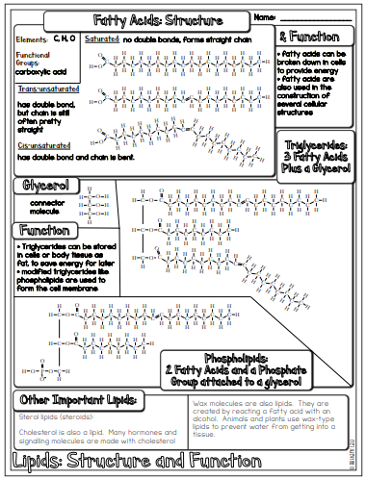
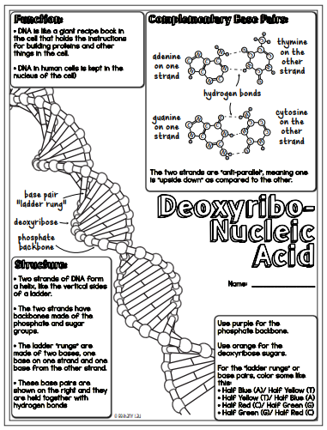
15
16

Slide 31
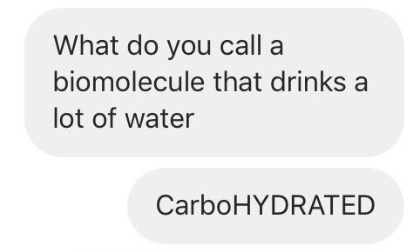
Wednesday 8-21-19
Pick up notes & get your journals.
Discussion questions:
The building blocks for polymers are:
The four types of macromolecules are:
You will need a green, yellow, red & blue colored pencil today (check your box ☺)

Slide 32
Wednesday 8-21-19
Objective
We will compare the functions of the different types of biomolecules.
Product
I will differentiate between the four types of biomolecules.

Slide 33
Nucleic Acids: Function of RNA
RNA strands are usually shorter than the long DNA strands and often carry genetic information (like photocopies) from DNA to other parts of the cell.
Some types of RNA act as "ribozymes" enzymes made of nucleic acid. Enzymes can catalyze chemical reactions. Many enzymes in the cell are made of protein.
Notes:
Ask students to think about the prefixes “mono” and “poly” to try to determine differences between these two molecules. Then, show the correct definitions.

Slide 34
Nucleic Acids: Function of RNA
There are some ribozymes that can self-replicate or build other RNA molecules.
Some can "stick" to amino acids helping them to speed up the reactions that involve proteins.
Notes:
Ask students to think about the prefixes “mono” and “poly” to try to determine differences between these two molecules. Then, show the correct definitions.

Slide 35
Nucleic Acids: Structure of RNA
RNA strands can be found in single stranded and double stranded form in the cell.
Just like DNA, sugar and phosphate groups make up the backbone.
RNA strands can base pair with other DNA or RNA strands, if they are complementary.
Notes:
Ask students to think about the prefixes “mono” and “poly” to try to determine differences between these two molecules. Then, show the correct definitions.

Slide 36
RNA World Hypothesis
Because some RNA can self-replicate and catalyze reactions, some scientists believe that primitive RNA was one of the first molecules to carry genetic information in very primitive organisms.
Some believe that RNA was used in living things before DNA and proteins.
Notes:
Ask students to think about the prefixes “mono” and “poly” to try to determine differences between these two molecules. Then, show the correct definitions.

Slide 37
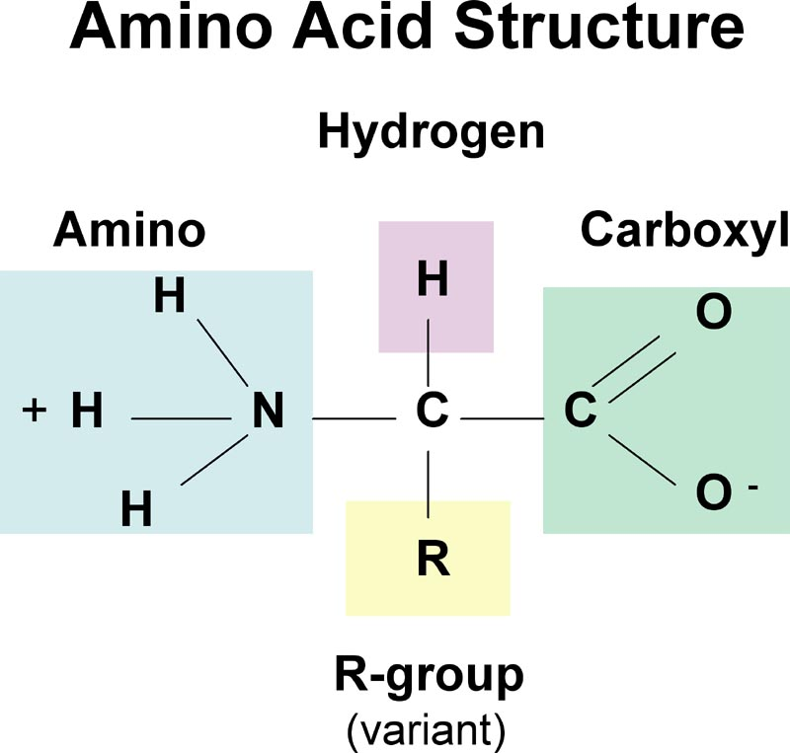
Protein: Structure
Amino Acids
Monomer: ________________
Polymers: chains of amino acids known as _____________ or ___________________
Proteins
Polypeptides

Slide 38
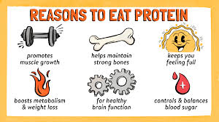
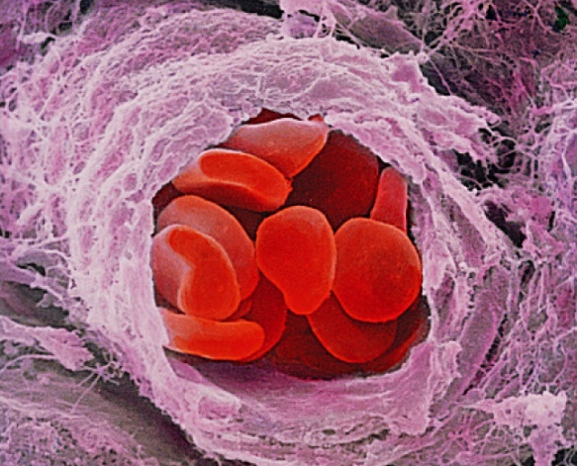
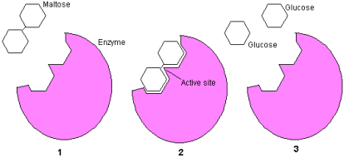
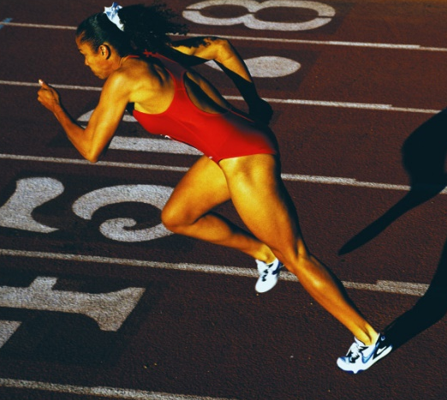
Protein: Functions
Main Functions: transport, support, enzymes, defense, structure and movement

Slide 39
Functions
Enzymes
Structure
Movement
Transport

Slide 40
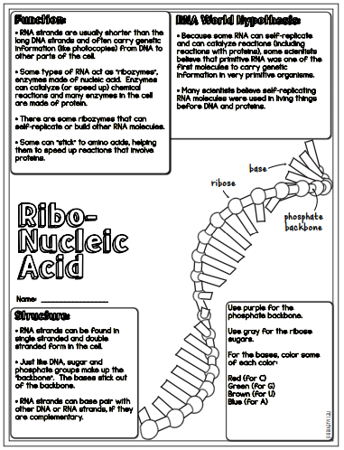
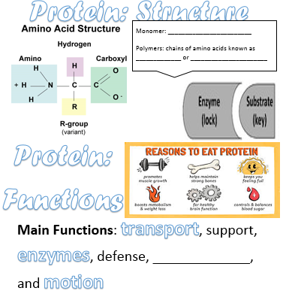
17
18

Slide 42
Table of Contents
Title | Left Page
Lab Safety Notes Pt. 1 | 1
Latin Root Words | 3
 | 5
 | 7
Characteristics of Life | 9
Organization of Life | 11
Biomolecule Notes | 13
Lipids | 15
Nucleic Acids (RNA) | 17
Title | Right Page
Lab Safety Notes Pt. 2 | 2
Scientific Method | 4
Unit 1 Cells & Viruses | 6
Characteristics of Life | 8
Characteristics of Life HW | 10
Organization of Life | 12
Carbohydrates | 14
Nucleic Acids (DNA) | 16
Proteins | 18

