Slide 1
Chemical Bonding
Unit 1 Chemistry of Life

Slide 2
Concept 2.1 Matter Composition
Matter consists of chemical elements in pure form and in combination.
  Pure form = Elements (CHONPS)
  Combinations = Compounds like CO₂ and H₂O

Slide 3
The Elements of Life
Just 4 elements make up approximately 96% of living matter
  Oxygen, Carbon, Hydrogen, and Nitrogen.
Trace elements
  Iron and Iodine

Slide 4
2.2 Structure of Atoms
Subatomic Particles
  Neutrons
  Protons
  Electrons
Each element has an atomic number and atomic mass
  Isotopes

Slide 5
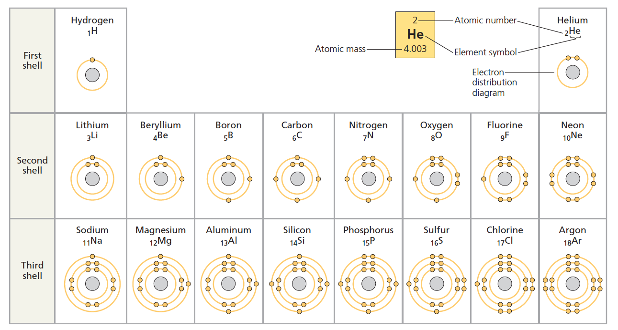

Slide 6
2.3 Chemical Bonds
Covalent Bonds
  Sharing of valence electrons
    Single Bonds
    Double Bonds
    Triple Bonds
Electronegativity
  Attraction of the particular atom for the electrons of a covalent bond

Slide 7
2.3 Chemical Bonds
Nonpolar Covalent Bonds – two atoms of the same element will equally share the electrons
Polar Covalent Bonds – When an atom is bonded to a more electronegative atom, the electrons are not shared equally

Slide 8
2.3 Chemical Bonds
Ionic Bonds: two atoms are so unequal in their attraction for valence electrons that the more electronegative atom strips the electrons from its partner.
  Ions
    Cations
    Anions

Slide 9
2.3 Chemical Bonds
Weak Chemical Interactions
  Hydrogen Bonds
  Van der Waals Bond

Slide 10
Structure of Water
Unit 1 Chemistry of Life

Slide 11
3.2 Properties of Water for Life
Cohesion
Adhesion
Surface Tension
Polarity

Slide 12
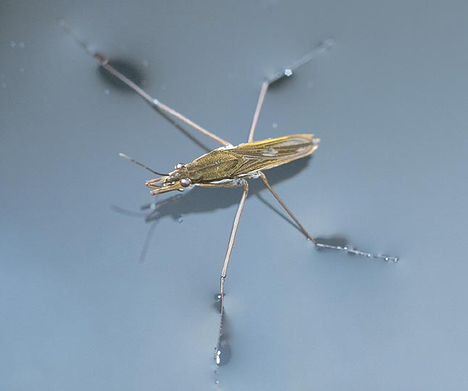
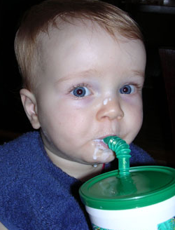
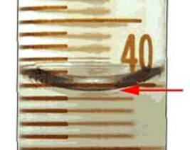
1. Cohesion & Adhesion
Cohesion
  H bonding between H₂O molecules
  water is “sticky”
    surface tension
    drinking straw
Adhesion
  H bonding between H₂O & other substances
    capillary action
    meniscus
    water climbs up
    paper towel or cloth
Try that
with flour…
or sugar…

Slide 13
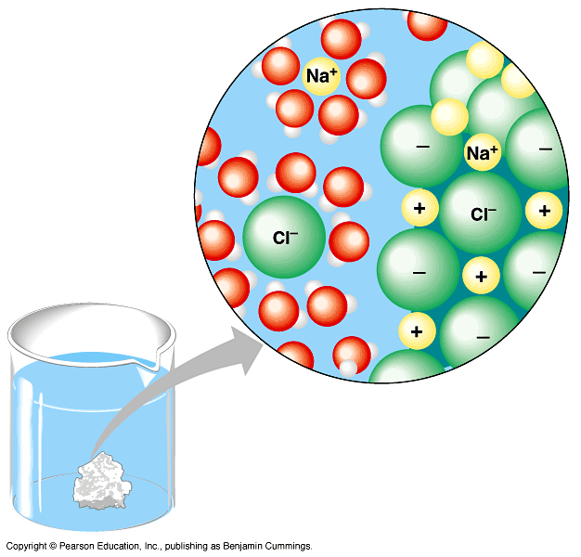
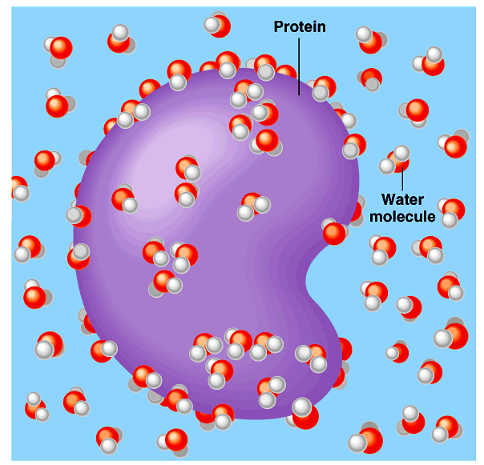
2. Water is the solvent of life
Polarity makes H₂O a good solvent
  polar H₂O molecules surround + & – ions
  solvents dissolve solutes creating solutions
Notes:
What dissolves in water easily?
polar or non-polar molecules?
How about Oxygen? Does that dissolve in H₂O?

Slide 14
3.2 Properties of Water for Life
High Specific Heat
The Solvent of Life
  Hydrophilic
  Hydrophobic

Slide 15
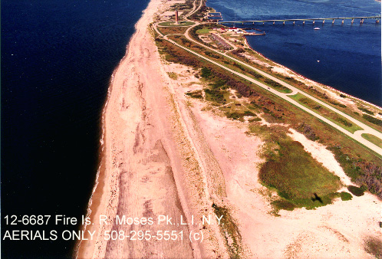
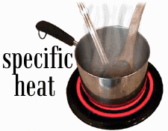
4. Specific heat
H₂O resists changes in temperature
  high specific heat
  takes a lot to heat it up
  takes a lot to cool it down
H₂O moderates temperatures on Earth

Slide 16
Ionization of water & pH
Water ionizes
  H⁺ splits off from H₂O, leaving OH–
    if [H⁺] = [⁻OH], water is neutral
    if [H⁺] > [⁻OH], water is acidic
    if [H⁺] < [⁻OH], water is basic
pH scale
  how acid or basic solution is
  1 → 7 → 14
H₂O → H⁺ + OH–

Slide 17

pH Scale
H⁺ Ion
Concentration
Examples of Solutions
pH
10⁰
0
Hydrochloric acid
10^{–1}
1
tenfold change
in H+ ions
pH1 → pH2
10⁻¹ → 10⁻²
10 times less H⁺
pH8 → pH7
10⁻⁸ → 10⁻⁷
10 times more H⁺
pH10 → pH8
10⁻¹⁰ → 10⁻⁸
100 times more H⁺
10^{–2}
2
Stomach acid, Lemon juice
10^{–3}
3
Vinegar, cola, beer
10^{–4}
4
Tomatoes
10^{–5}
5
Black coffee, Rainwater
10^{–6}
6
Urine, Saliva
10^{–7}
7
Pure water, Blood
10^{–8}
8
Seawater
10^{–9}
9
Baking soda
10^{–10}
10
Great Salt Lake
10^{–11}
11
Household ammonia
10^{–12}
12
Household bleach
10^{–13}
13
Oven cleaner
10^{–14}
14
Sodium hydroxide
Notes:
In pure water only 1 water molecule in every 554 million is dissociated

